Slide 1
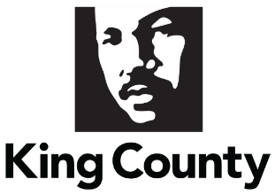
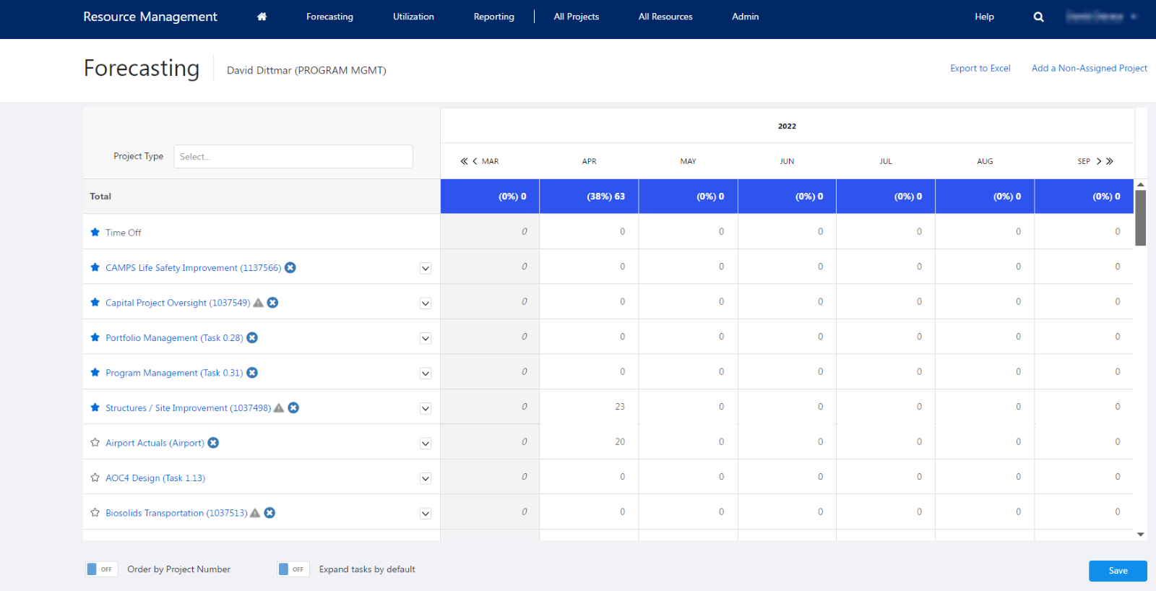
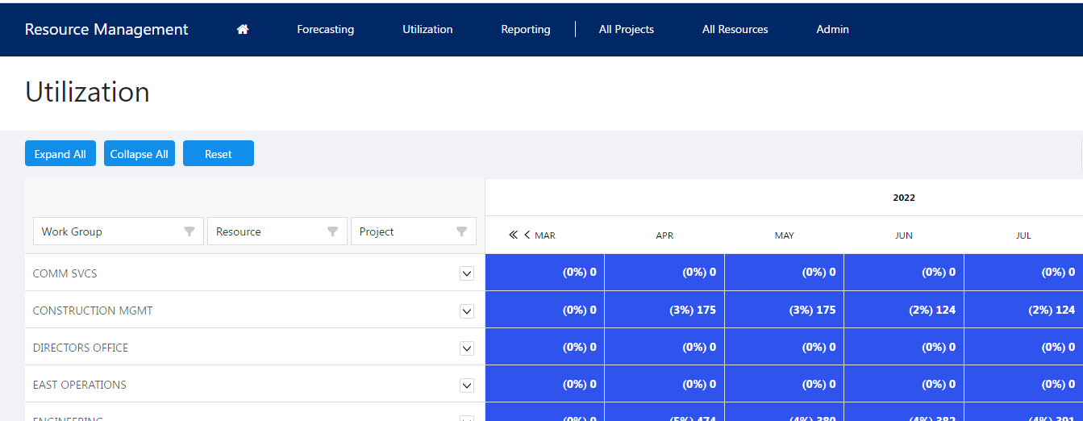
King County Resource Management
Business Need
King County's Wastewater Treatment Division (WTD) required a comprehensive Resource Management Tool (RMT) to streamline and enhance their operations. The division faced challenges in managing resources efficiently, forecasting, project management, and reporting. The need was for a system built on robust technology that could handle dynamic project requirements, provide detailed forecasting and utilization insights, and support data-driven decision-making processes.
What We Did
Affirma, in collaboration with King County WTD, designed and developed the RMT from the ground up, leveraging Microsoft Azure Cloud technology. The development process involved several discovery sessions with WTD's business group to understand their specific needs and requirements. The tool's architecture and design were crafted to provide a scalable and flexible solution that included:
Customized project and resource management features.
Forecasting and utilization modules to help in planning and tracking.
Detailed reporting and analytics capabilities for better insight into operations.
Integration with existing systems for seamless data flow and consistency.
User-friendly UI/UX designed for ease of use and efficiency.
Results
The deployment of the RMT brought about significant improvements in King County WTD's resource management and operational efficiency. Key outcomes included:
Enhanced forecasting accuracy and project management capabilities.
Improved resource utilization and efficiency, reducing operational costs.
Better decision-making supported by comprehensive reporting and analytics.
Increased user adoption and satisfaction due to the intuitive design and usability of the tool.
Successful handling of complex business rules and requirements, demonstrating the tool's flexibility and scalability.

Slide 2
King County Resource Management Tool
Business Need
King County's Wastewater Treatment Division (WTD) required a comprehensive Resource Management Tool (RMT) to streamline and enhance their operations. The division faced challenges in managing resources efficiently, forecasting, project management, and reporting. The need was for a system built on robust technology that could handle dynamic project requirements, provide detailed forecasting and utilization insights, and support data-driven decision-making processes.
What We Did
Affirma, in collaboration with King County WTD, designed and developed the RMT from the ground up, leveraging Microsoft Azure Cloud technology. The development process involved several discovery sessions with WTD's business group to understand their specific needs and requirements. The tool's architecture and design were crafted to provide a scalable and flexible solution that included:
Customized project and resource management features.
Forecasting and utilization modules to help in planning and tracking.
Detailed reporting and analytics capabilities for better insight into operations.
Integration with existing systems for seamless data flow and consistency.
User-friendly UI/UX designed for ease of use and efficiency.
Results
The deployment of the RMT brought about significant improvements in King County WTD's resource management and operational efficiency. Key outcomes included:
Enhanced forecasting accuracy and project management capabilities.
Improved resource utilization and efficiency, reducing operational costs.
Better decision-making supported by comprehensive reporting and analytics.
Increased user adoption and satisfaction due to the intuitive design and usability of the tool.
Successful handling of complex business rules and requirements, demonstrating the tool's flexibility and scalability.

